Slide 1
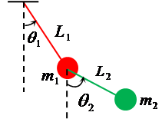
Enhancing RC4 Stream Cipher Using Chaotic Double Pendulum-Based Key Generation and Improved Key Scheduling Algorithm
EG/2022/5368 Theekshana A.P.K.
EG/2022/5369 Thennakoon T.M.R.G.
EG/2022/5374 Thurga R.
EG/2022/5377 Uduwawala W.B.W.M.R.S.H.

Slide 2
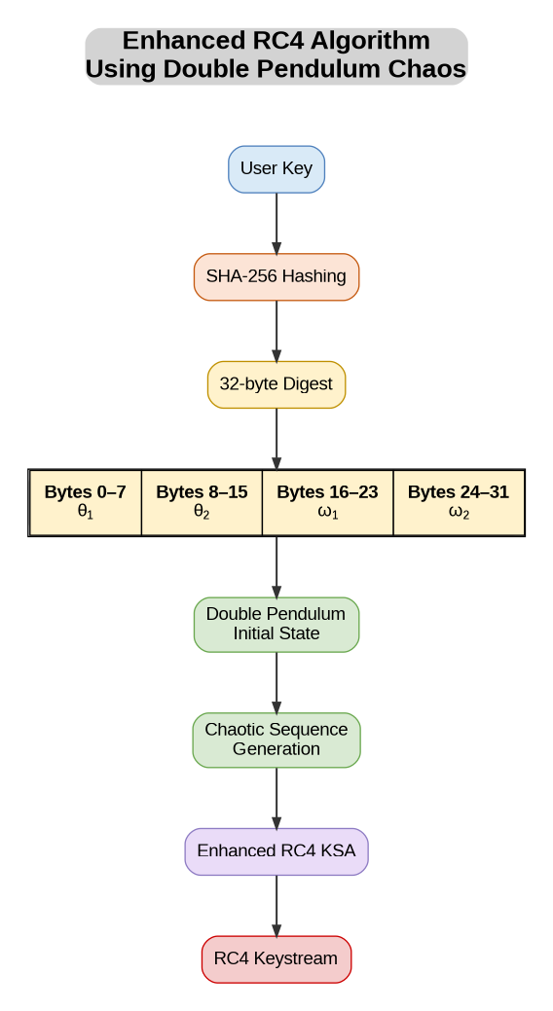
Algorithm

Slide 3
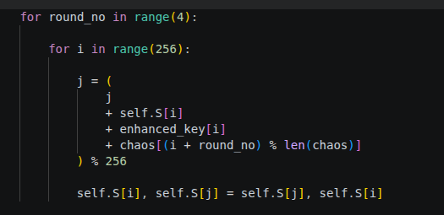
Enhanced KSA

Slide 4
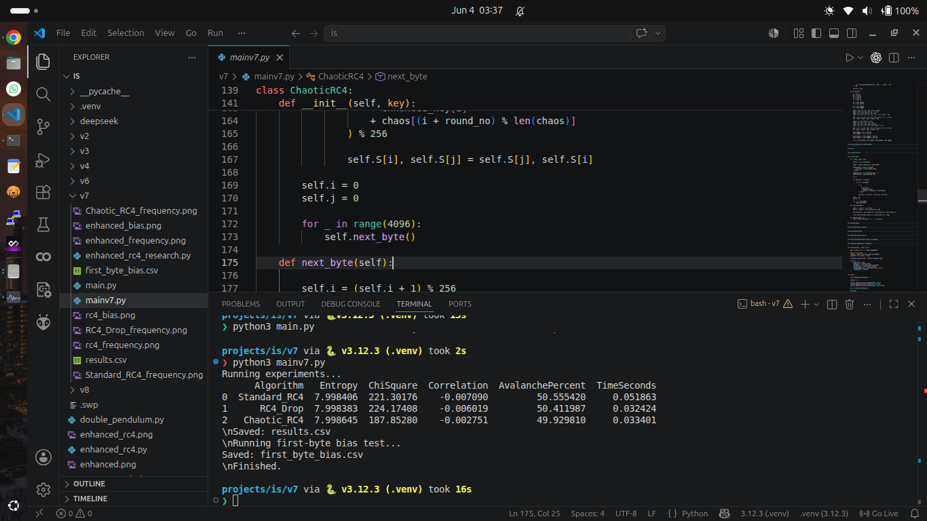

Slide 5
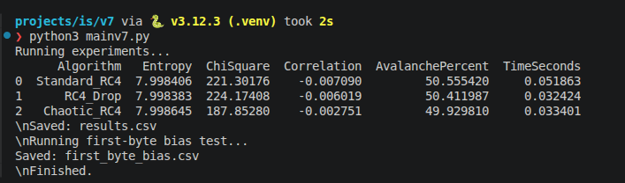

Slide 6
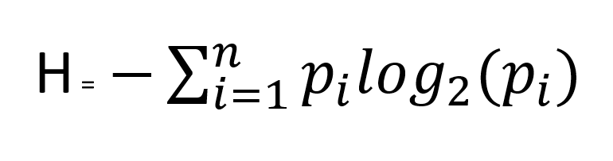
Shannon entropy formula:

Slide 7
For a perfectly uniform 256-byte distribution, each possible byte value has probability 1/256.
H = -Σᵢ₌₁²⁵⁶ (1/256) log₂(1/256)
Since every term is identical:
H = -256 × (1/256) × log₂(1/256)
and
log₂(1/256) = log₂(2⁻⁸) = -8
Therefore:
H = -1 × (-8) = 8
Final answer: H = 8 bits per byte
This means the maximum entropy for an 8-bit byte stream is 8 bits per byte. If the generated keystream entropy is close to 8, it indicates good randomness.

Slide 8
THANK YOU

